Slide 1
Git & GitHub
Please download and install Git before we start!
Git can be found at https://git-scm.com/downloads/
Notes:
Hello! I’m Zach from PantherHackers and today we’re going to learn how to use the popular code versioning system Git. During this presentation, if you have any questions, please don’t hesitate to raise your hand, I want to make sure everyone gets to understand Git.

Slide 2
The Plan:
What is Git?
Core concepts overview
Git download and setup
Creating a repository and doin’ stuff to it
GitHub tutorials
Notes:
In this workshop, we’ll first learn the theoreticals of what Git is, why it’s good, and the basic concepts you need to understand how it works. Then we’ll make sure everyone gets Git up and running on their PCs. Then we’ll get hands-on with some fundamental Git operations and after that we’ll move on to learning GitHub.

Slide 3

What is Git?
Git is not…
…a single website (for example, GitHub or BitBucket)
…just a way to share code
Git is…
…a distributed version control system (DVCS)
…a way to keep track of changes in your code
…a way to collaborate with people on the same codebase
...a way to look back through time
Notes:
So what is Git? Well, let’s clear up some misconceptions first. Git is more than just a single website. You might have heard of GitHub or BitBucket, which are both well-known Git hosting providers. Although these services use Git, they are not Git. Git is also more than just a way to collaborate on a codebase. Git is is a distributed version control system. What that means is that anyone who has a copy of a Git repository (also known as a “clone”) can view and sift through all changes made to the code over time. That makes it an excellent collaboration tool when used with services like GitHub which enable you to have multiple people working on one repository and one codebase independently of one another. This is because Git automatically keeps track of who wrote what code and what time changes were made. This is especially important for larger projects which use Git such as the Linux kernel.

Slide 4
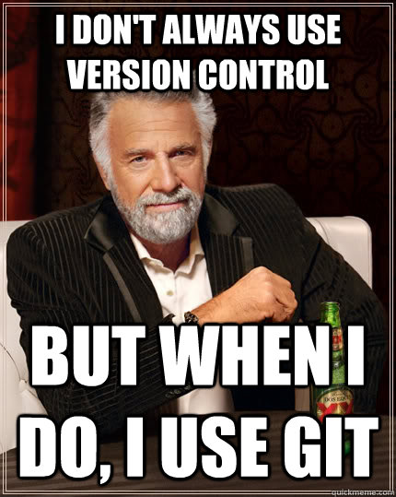
Why should you use Git?
Git is a Distributed Version Control System (DVCS)
Git solves two problems in software engineering:
Version control – keeping track of changes made to your code over time
Collaboration (distributed) – many people can connect to a Git server to work on one codebase, people can work on the codebase locally without having to connect to save changes
Makes collaboration easier
Changes can be merged from forked repos
It’s the industry standard
Used by Google, Facebook, Microsoft, Twitter, Netflix, Android, and the Linux Foundation
Notes:
So why should you use Git? Well, Git tackles two big problems that occur in any complex software engineering project. Git is a distributed version control system. The “version control system” part of that phrase means that Git will keep track of every version of your code that you create as long as you remember to commit your code regularly. The “distributed” portion of the acronym indicates that Git can be hosted on a server – for example, GitHub – and multiple people can connect to the Git server synchronize their local working copy of the code with the authoritative version maintained by the project owner. Besides these major technical benefits, knowing how to use Git (and GitHub) is an essential skill if you want to be gainfully employed as a software engineer. Today, we are learning the industry standard tools for version control and code collaboration.

Slide 5
Concepts Overview
Notes:
So let’s look at some concepts you’ll need to understand Git.

Slide 6
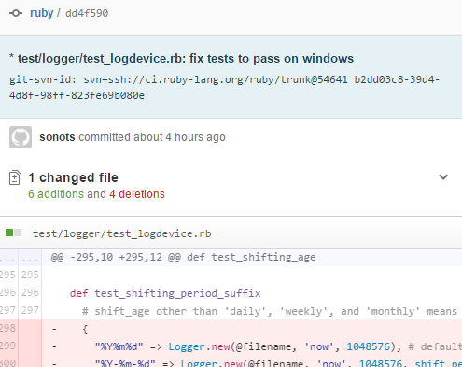
Key Concepts
Things you need to know to understand Git:
Repository – container for the project
Branch – an offshoot of the repository to contain a set of changes, diverges at a commit
Can be “merged” into another branch to combine the changes made on each
Common pattern is for contributors to clone repository, create branch, push branch up to GitHub (ex), and then have project maintainer merge the branch into a “master” or “develop” branch
Commit – a timestamped set of changes to your files
Notes:
There are three nouns we need to define to understand Git at a basic level.
A repository can be viewed as the container for all of your project’s files, commits, and changes over time. Typically, a simple project will only consist of a single repository.
If you visualize a repository as a tree, then it’s simple to see where branches come in. When they clone your code, developers can create new branches on existing repositories in order to organize their work and to keep it separate from others. Then, when their work is complete – whether it be a new feature, a bug fix, or something else – they can do something call a “pull request” to the maintainer of the original repository, and the maintainer can easily use Git’s tools to merge in the commits.
A commit stores the time of a change and the deltas (or “change”s) which the developer has chosen to commit. So a single commit can represent a single small change or thousands of changes, it is entirely up to the discretion of the developer.

Slide 7
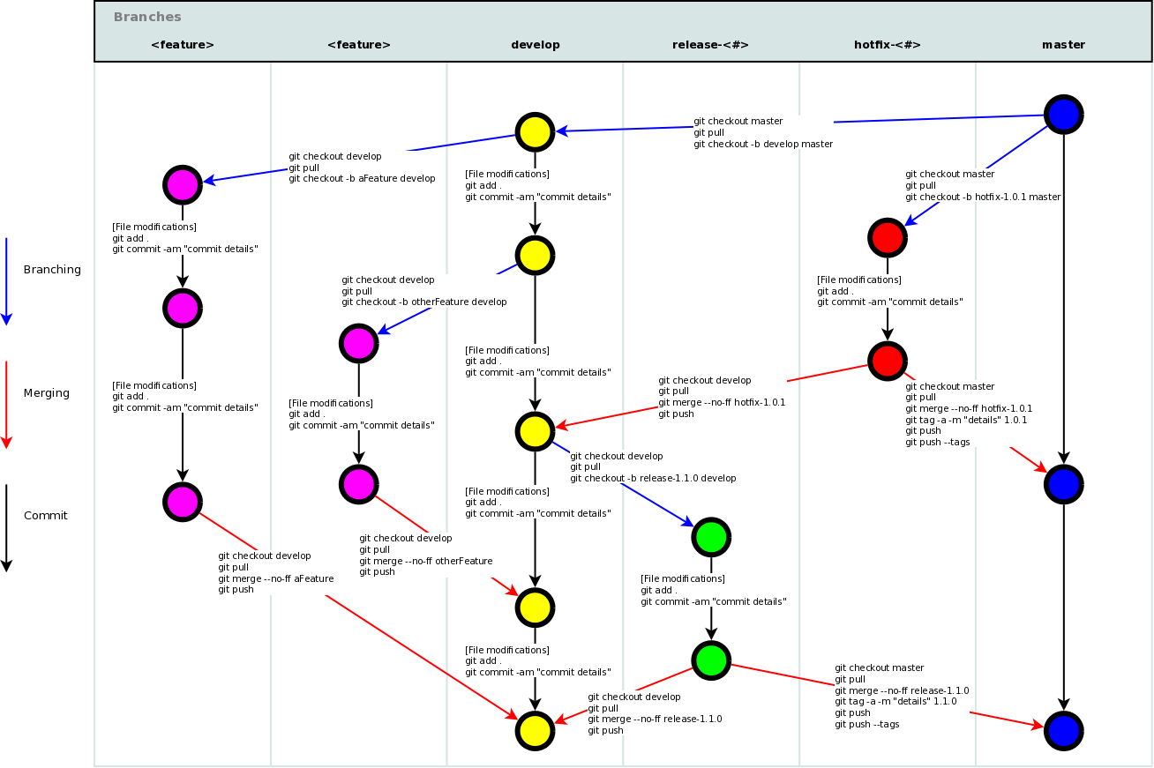
Notes:
So this is a pretty scary picture to look at. In terms of complexity. But if you inspect it, you will see that you actually understand everything that is going on. We’re going to use this diagram to demonstrate a few paths in a Git workflow.
So the first thing you gotta understand about this picture is that it represents a single repository. Up here in the top right, this blue circle, this is the initial commit – so this is like where they started their code base from. And each one of these colored circles represents a single commit. And each column is a branch. So as you can see there’s a lot of paths to follow here, let’s explore just one or two. [start from master and explore a few paths]

Slide 8
Git Download and Setup
Notes:
So let’s get running with Git.

Slide 9
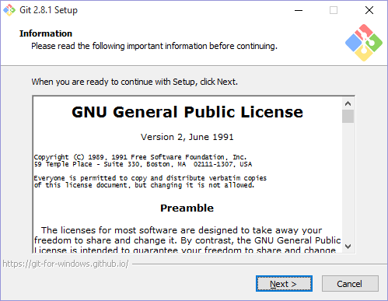
How to install Git
Go here: https://git-scm.com/download
Select your operating system
Download and run the installer using defaults
If you are running Linux, you should be able to install Git via your package manager: apt-get install git yum install git
Notes:
Go to this URL and install Git.

Slide 10
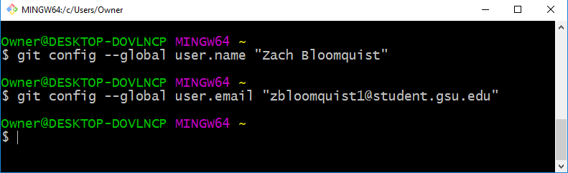
Initial Git Setup
Open up Terminal (Mac) or Git Bash (Windows)
Mac: Press Command-O and type “Terminal” to find Terminal
Windows: Press the Windows key and type “Git Bash” to find Git Bash
Use git config to configure git as demonstrated

Slide 11
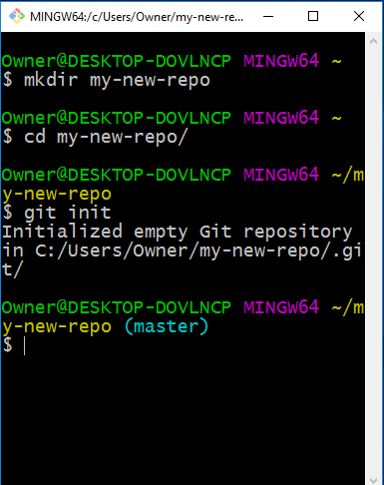
Creating your first Repository
Open up Git Bash (Windows) or Terminal (OSX/Linux)
Create a new directory using “mkdir”
Enter the new directory using “cd”
Initialize the repository using “git init”
All Git commands are in the form “git <command> [arguments]”
Create a text file or two and save it to your project’s folder
Once you’ve created some files, use these commands to check them and add them to your Git repo:
git status – provides information about what changes currently belong to your Git repository
git add filename.txt – adds (“stages”) filename.txt to the changes being tracked for the next commit
git commit –m “Commit message” – creates a commit from the files changed via git add.
Notes:
We’ll walk through creating your first repository from scratch. Git is a command-line tool, so to use it, either open up Git Bash which is included with Git for Windows or open up Terminal if you’re on Mac or Linux. Using the command-line, create a new directory with mkdir and open it using cd. Now we’re ready to begin using Git. Every command that invokes Git begins with the word git followed by the command that you are trying to use such as push or pull. When you want to use Git for a project, you can type git init to create the database that will track your changes. Then, once you have some files in your directory, you use git add to “stage”, or prepare, the changes to be committed. Git commit with the dash-m option will create a new commit and use the supplied message to mark it with.

Slide 12
GitHub

Slide 13
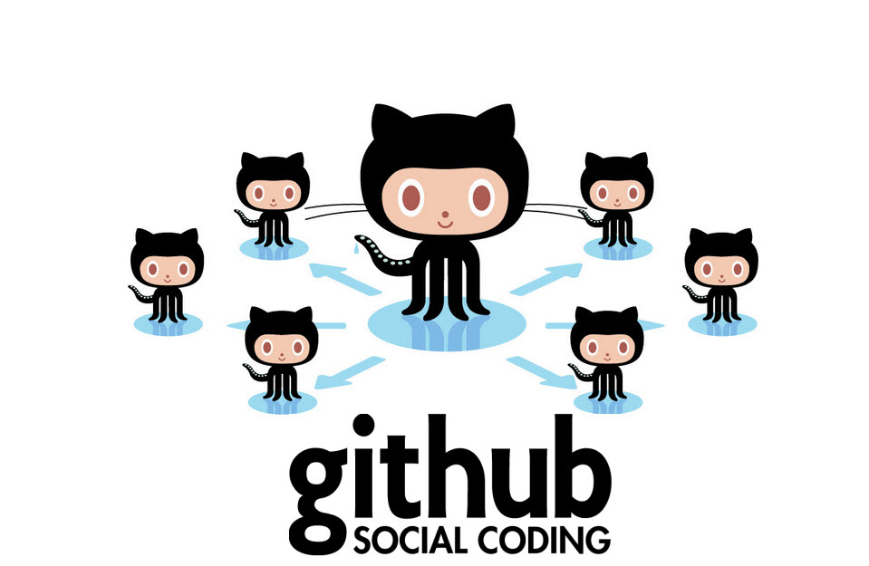
What is GitHub?
GitHub hosts your Git repositories on their servers
They provide a web interface to visually inspect source code, commit history, branches, pull requests, and forks of the repo
GitHub makes it easy to collaborate on a Git repository

Slide 14

GitHub Hands-On
Registering
Creating a repo from local repository
Forking an existing repo
Cloning your fork of the repo
Adding commits
Pushing back to GitHub
Making a pull request to the original repo

Slide 15
Resources

Slide 16
Questions?

